Slide 1
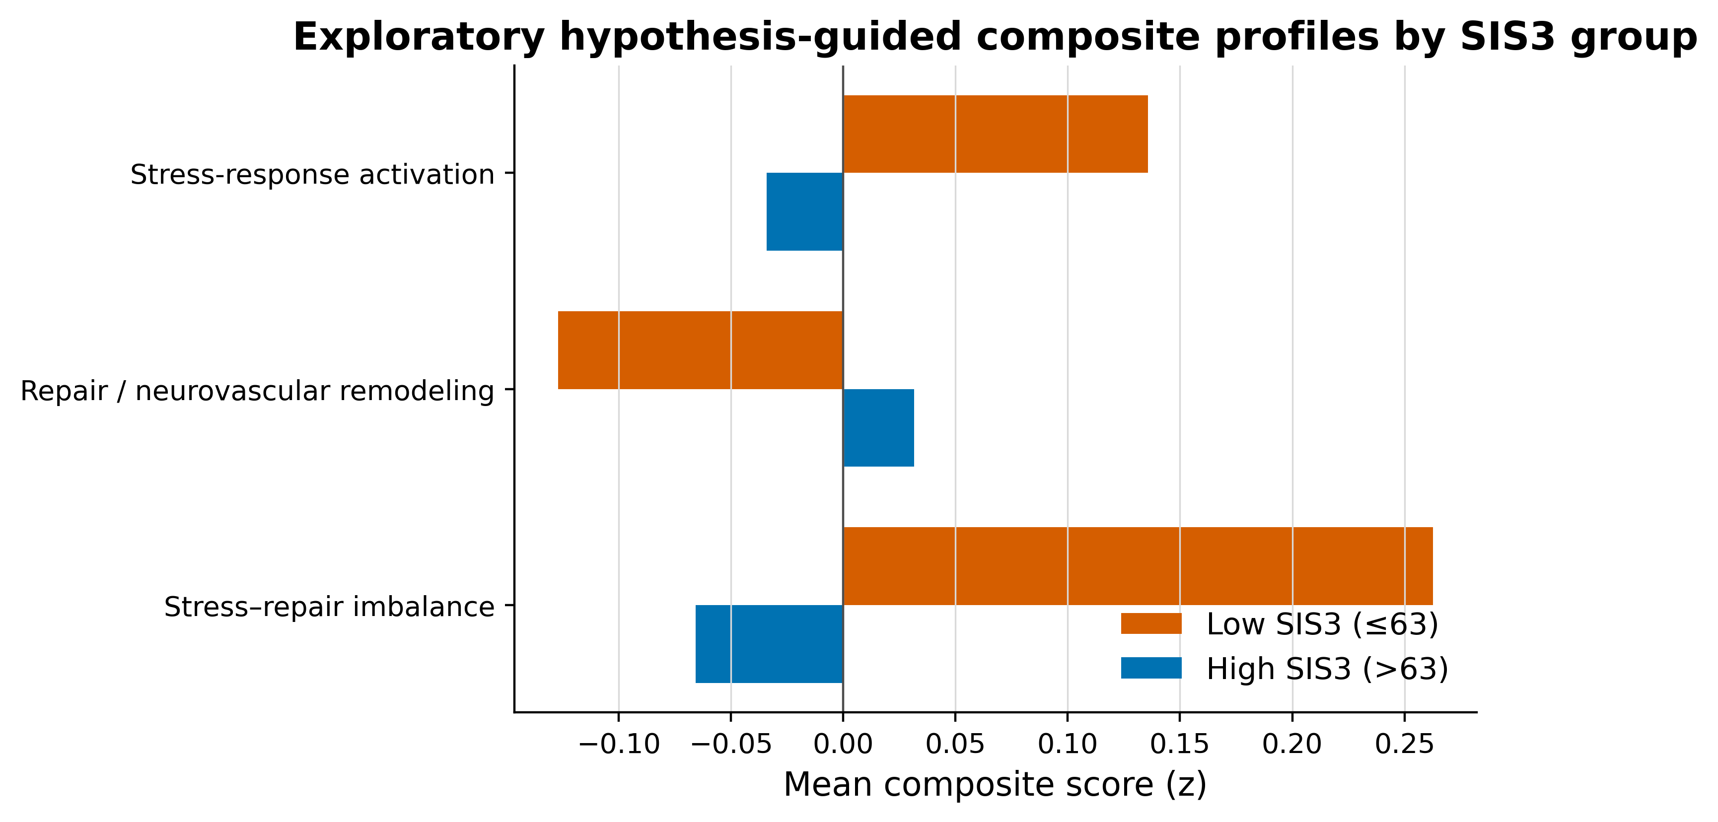
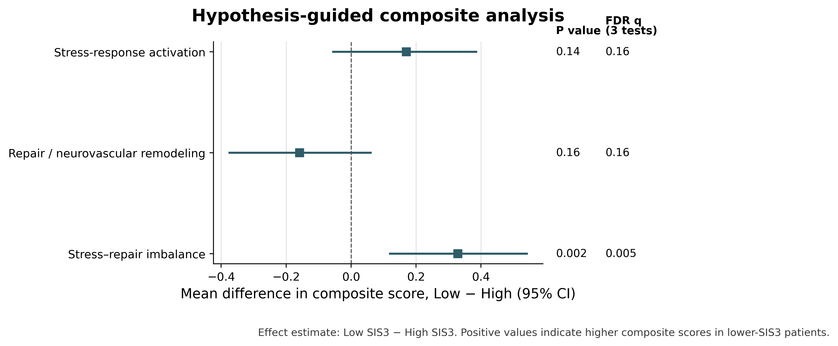

Slide 2
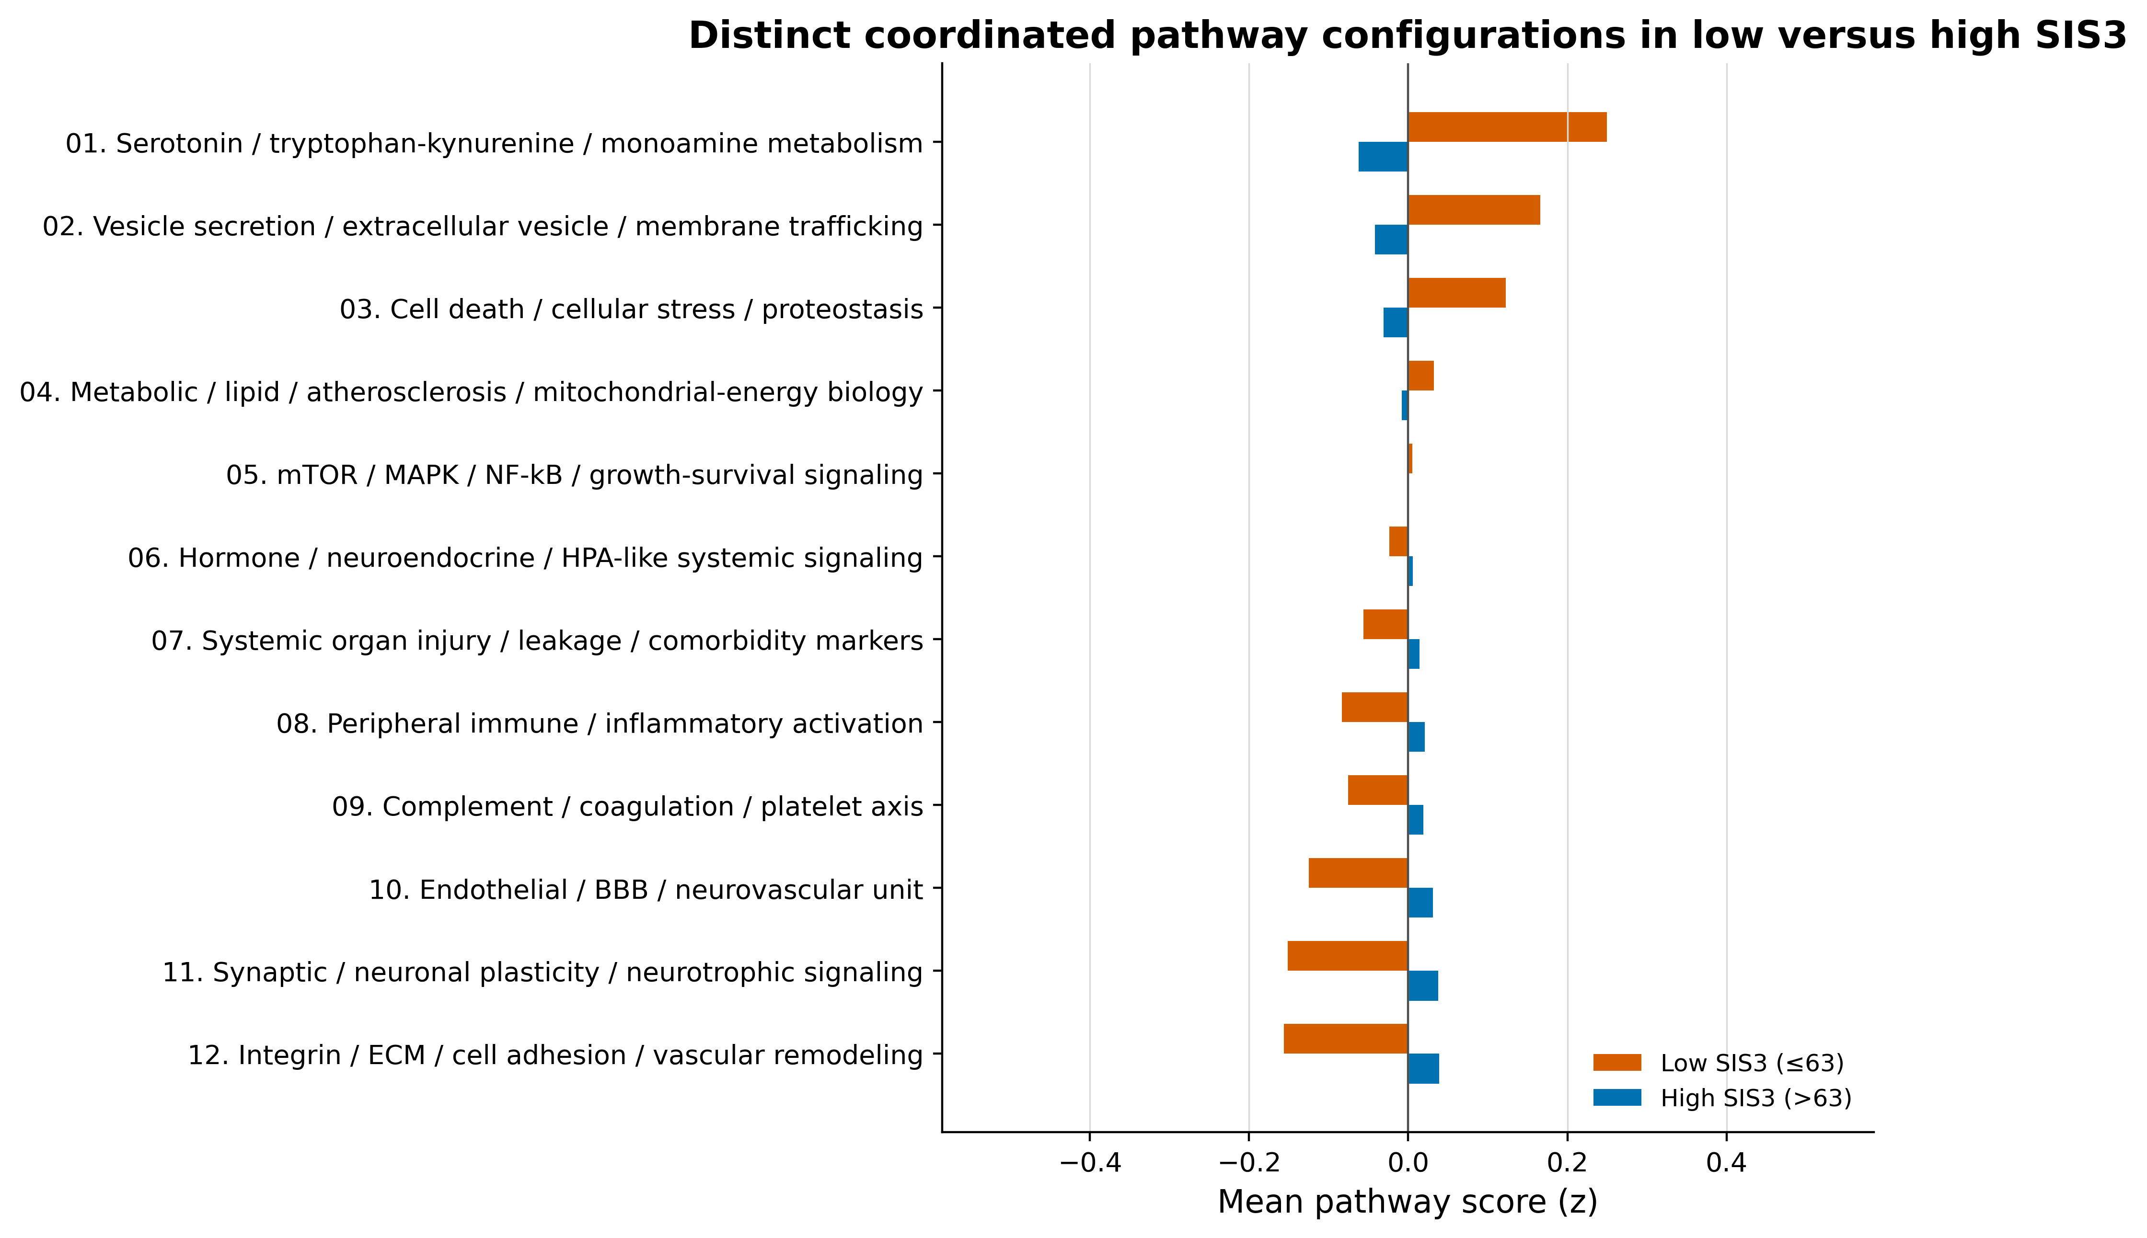
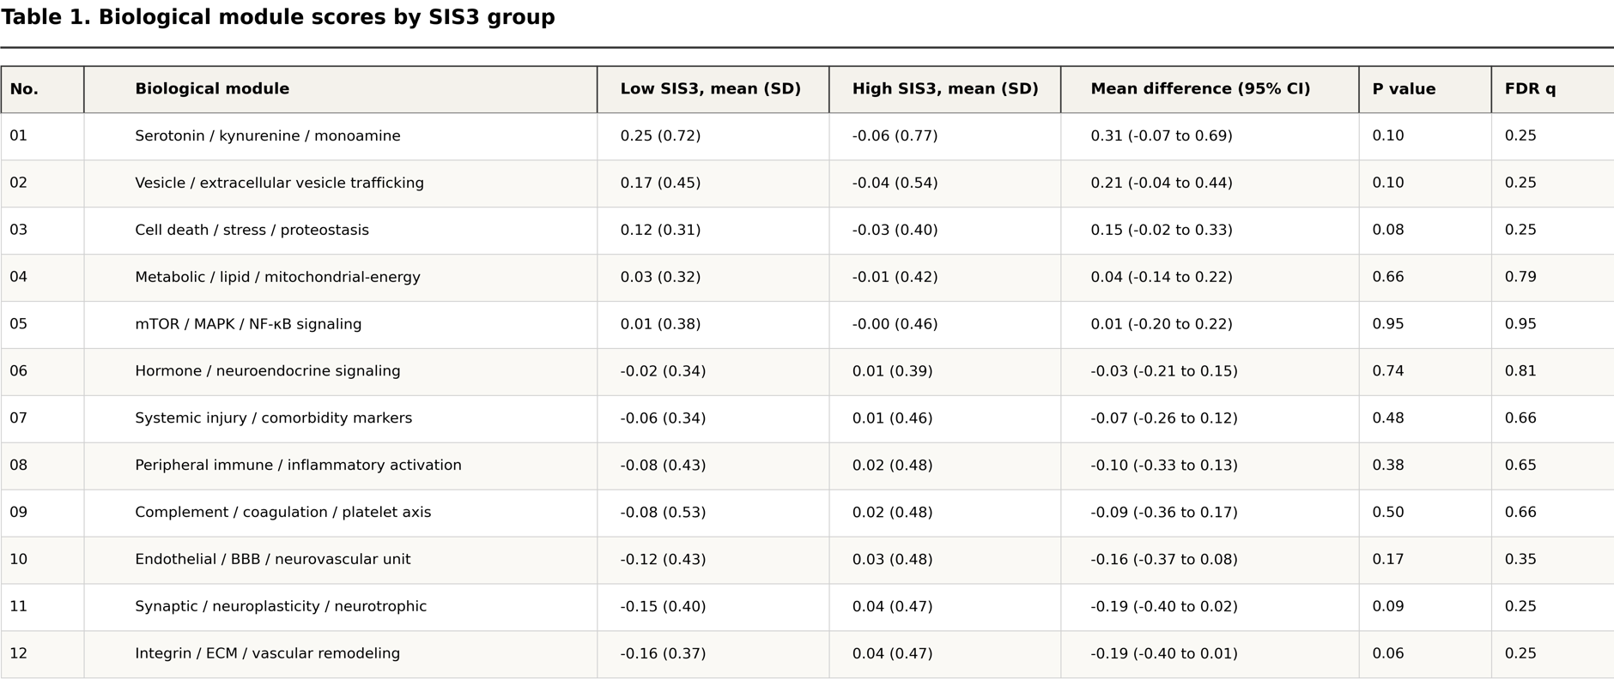
Multi-module plasma protein profiles distinguish lower versus higher SIS3 groups.
Bars show the mean biological module score in patients with lower SIS3 versus higher SIS3. Each biological module summarizes a set of plasma proteins linked to processes relevant to chronic stroke, mood regulation, inflammation, vascular injury, systemic stress, and recovery. Because biological functions overlap, some proteins were allowed to contribute to more than one module.
Positive and negative values indicate module activity above or below the cohort average.
Lower SIS3 was associated with a more polarized module profile, with relative activation of monoamine/vesicle/stress-related signals and relative restraint of vascular-remodeling, immune-coagulation, and neuroplasticity-related modules. In contrast, higher SIS3 showed a more generally suppressed module pattern, suggesting that worse mood may reflect disrupted coordination between stress-response and repair biology.
Methods: Mean biological module scores were calculated from raw Olink NPX data. Low-detection proteins were removed, retained proteins were z-scored across patients, and proteins were assigned to one or more literature-aligned biological modules. For each patient, each module score was calculated as the average z-scored NPX value of retained proteins assigned to that module. Lower SIS3 (threshold 63) indicates worse mood/emotional function.
p values compare patient-level module scores between lower- and higher-SIS3 groups using two-sided Mann–Whitney U tests. Confidence intervals show bootstrap 95% CIs for the mean difference, Low SIS3 minus High SIS3.

Slide 4
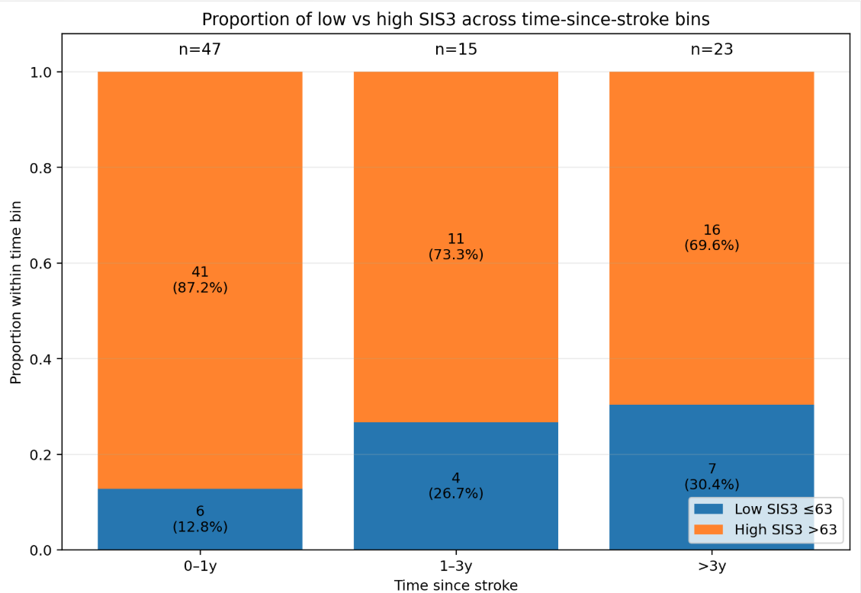
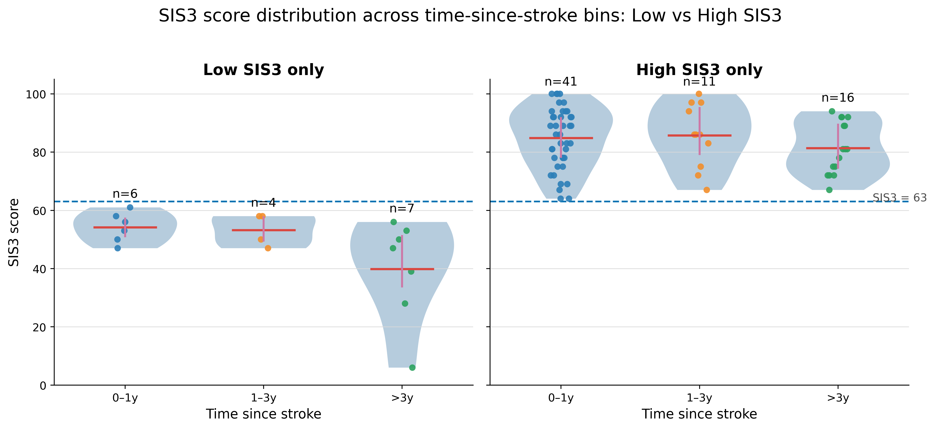
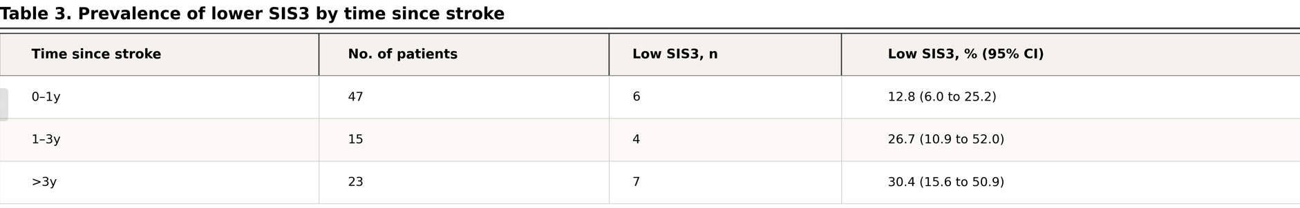
Distribution of SIS3 mood scores across time since stroke
Patients were grouped by time since stroke and split into lower SIS3 (≤63) and higher SIS3 (>63). The proportion of lower-SIS3 patients increased across later time bins.
Violin plots show that lower-SIS3 patients, especially beyond 3 years, had lower average SIS3 scores and greater variability, whereas higher-SIS3 patients remained clustered above SIS3 threshold. These patterns suggest that post-stroke mood impairment may reflect a heterogeneous phenotype at late-stage, motivating the next step of testing whether distinct biological module profiles underlie lower versus higher SIS3 groups.

Slide 5
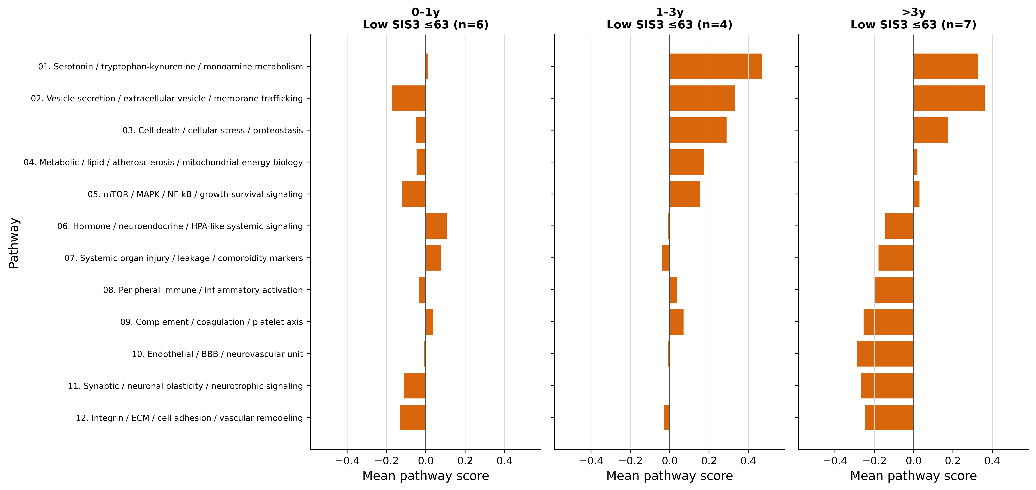
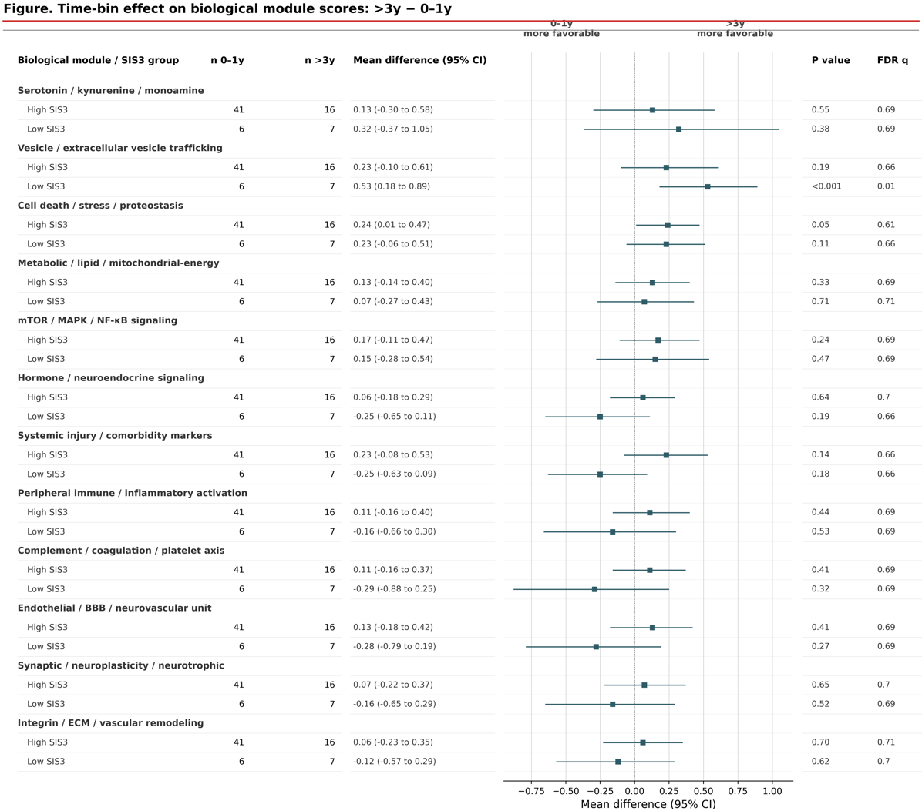
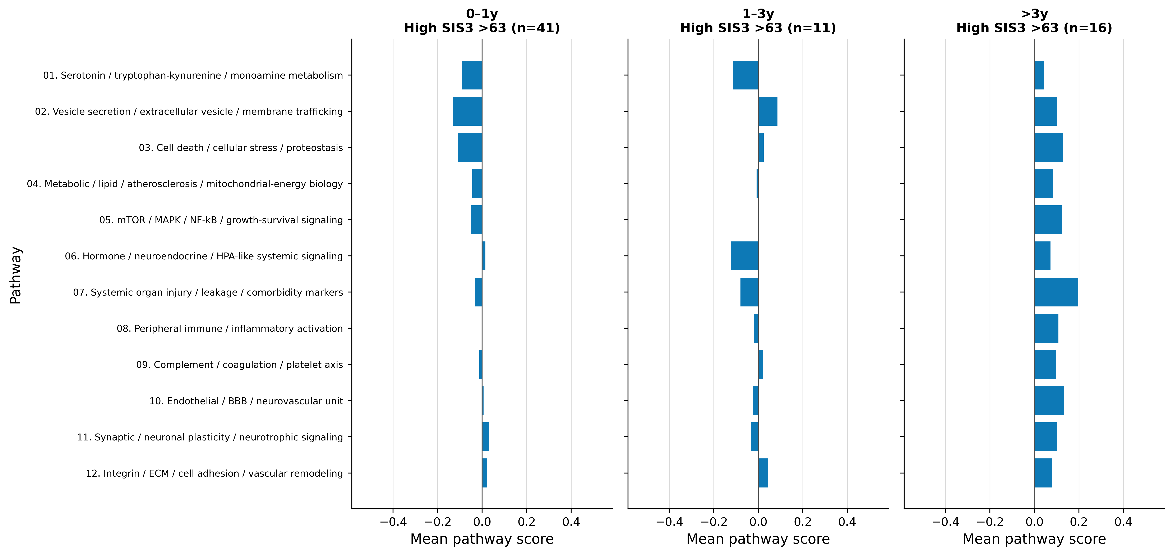
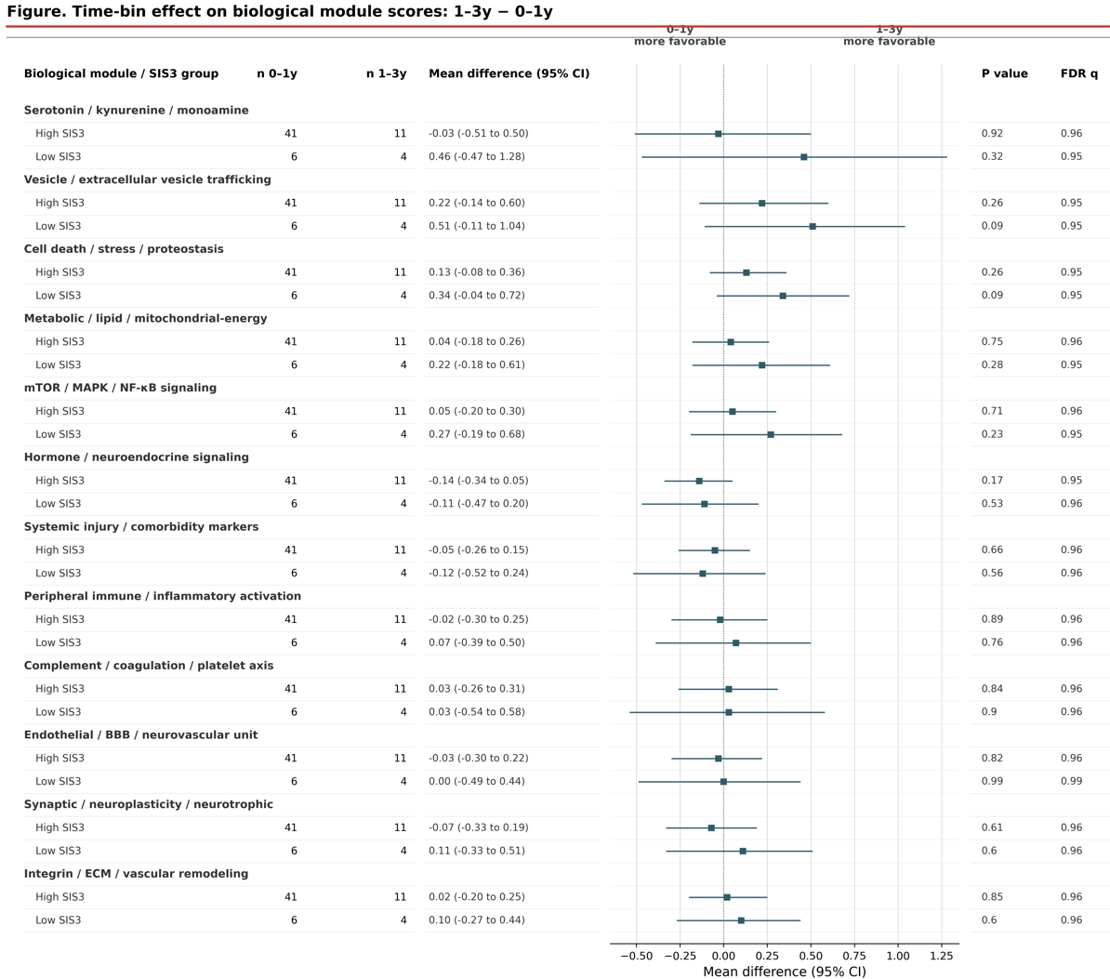
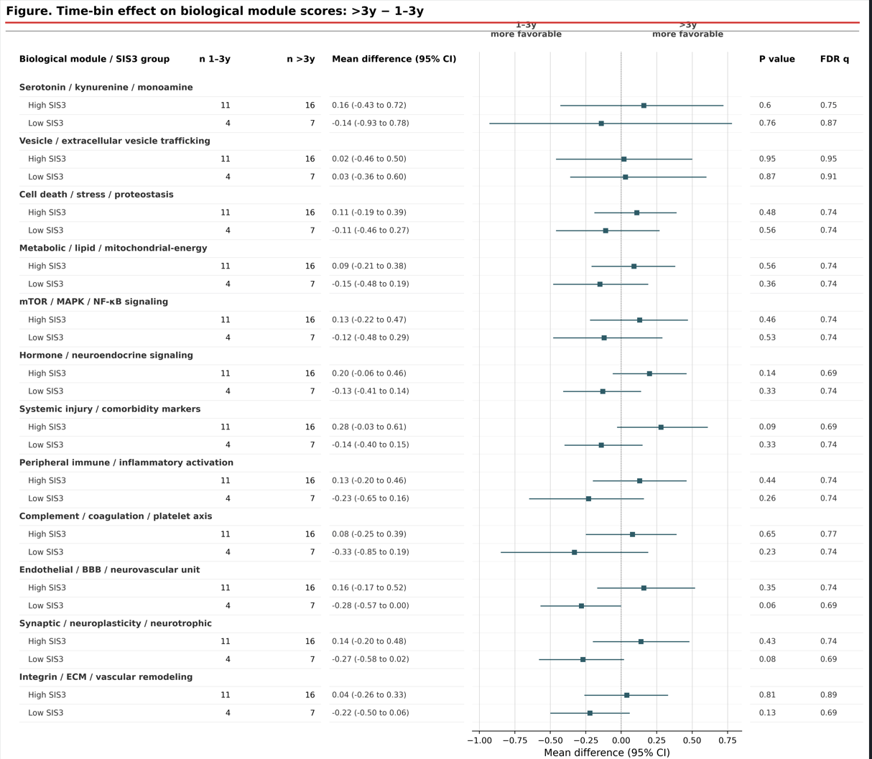
Low SIS3 group exhibits time-dependent biological shift
Patients were stratified by time since stroke and SIS3 group.
Lower SIS3 showed a time-dependent module shift: stress/monoamine/vesicle-related signals became relatively higher, while vascular-remodeling, immune-coagulation, endothelial/BBB, and neuroplasticity-related modules became relatively lower, especially beyond 3 years. In contrast, higher-SIS3 patients showed smaller module shifts and remained closer to the cohort average across time bins.
The 1–3 year period may represent a potential intervention window, marked by increased monoamine, vesicle-trafficking, and stress-related module activity. Late-stage signatures may help guide earlier intervention strategies aimed at rebalancing stress-response and repair biology. The 1–3 year profile may guide 0–1 year prevention strategies, whereas the >3 year signature may guide interventions during the 1–3 year transition window.

Slide 6
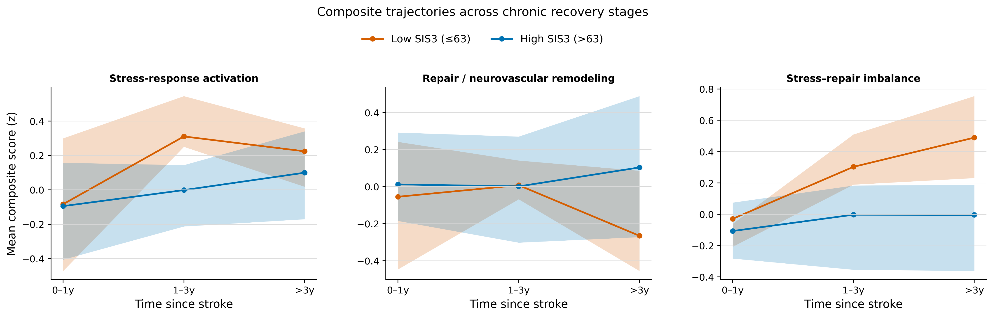

Slide 8
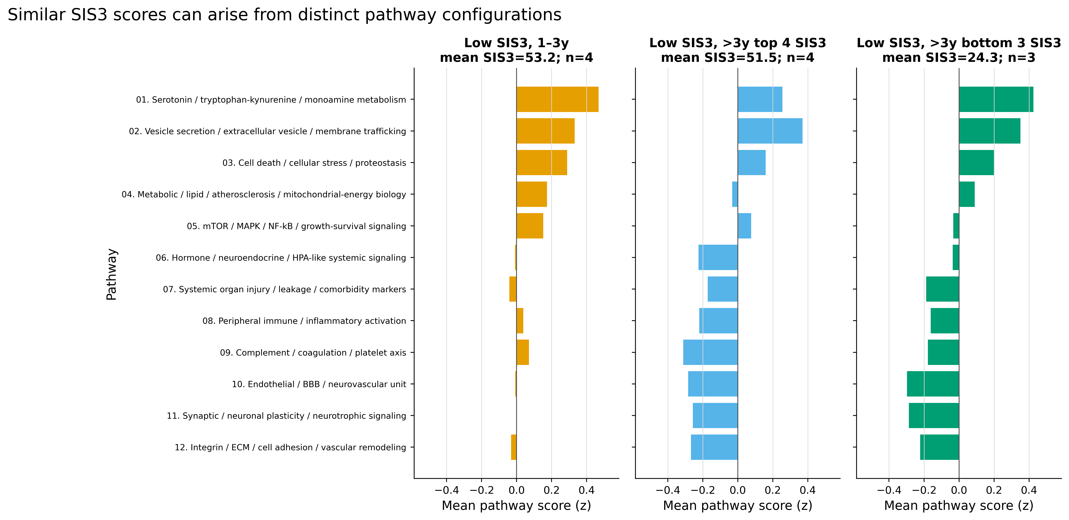
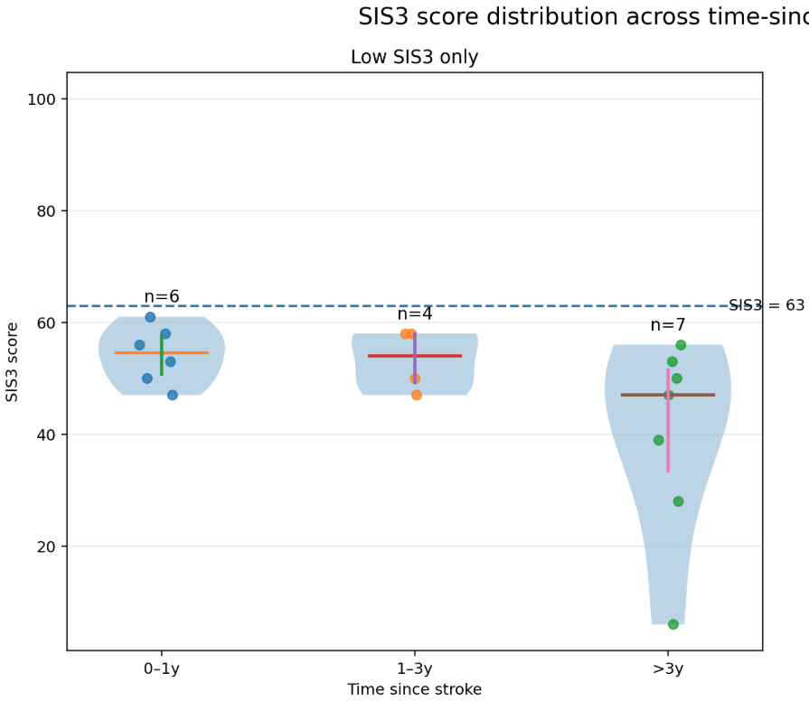
Similar SIS3 scores can reflect different plasma protein module profiles, while similar late-stage profiles can still correspond to different symptom severity.
Among lower-SIS3 patients, the 1–3 year group and the >3 year top-SIS3 subgroup had similar average SIS3 scores but distinct biological module profiles, suggesting that similar mood scores may arise from different underlying biology. In contrast, the >3 year top- and bottom-SIS3 subgroups shared a more similar late-stage module pattern, but differed in SIS3 severity, suggesting that profile intensity may influence clinical expression.
These patterns indicate that a new patient’s protein profile should be interpreted within its time-since-stroke context.

Slide 9
Earlier biological profiles may foreshadow later mood impairment
If biological changes precede clinical expression, 0–1 year profiles may help predict 1–3 year SIS3 status, while 1–3 year signatures may help anticipate late-stage mood impairment beyond 3 years. This is a hypothesis from the this cross-sectional data; longitudinal data are needed to confirm within-patient biological progression.

Slide 10
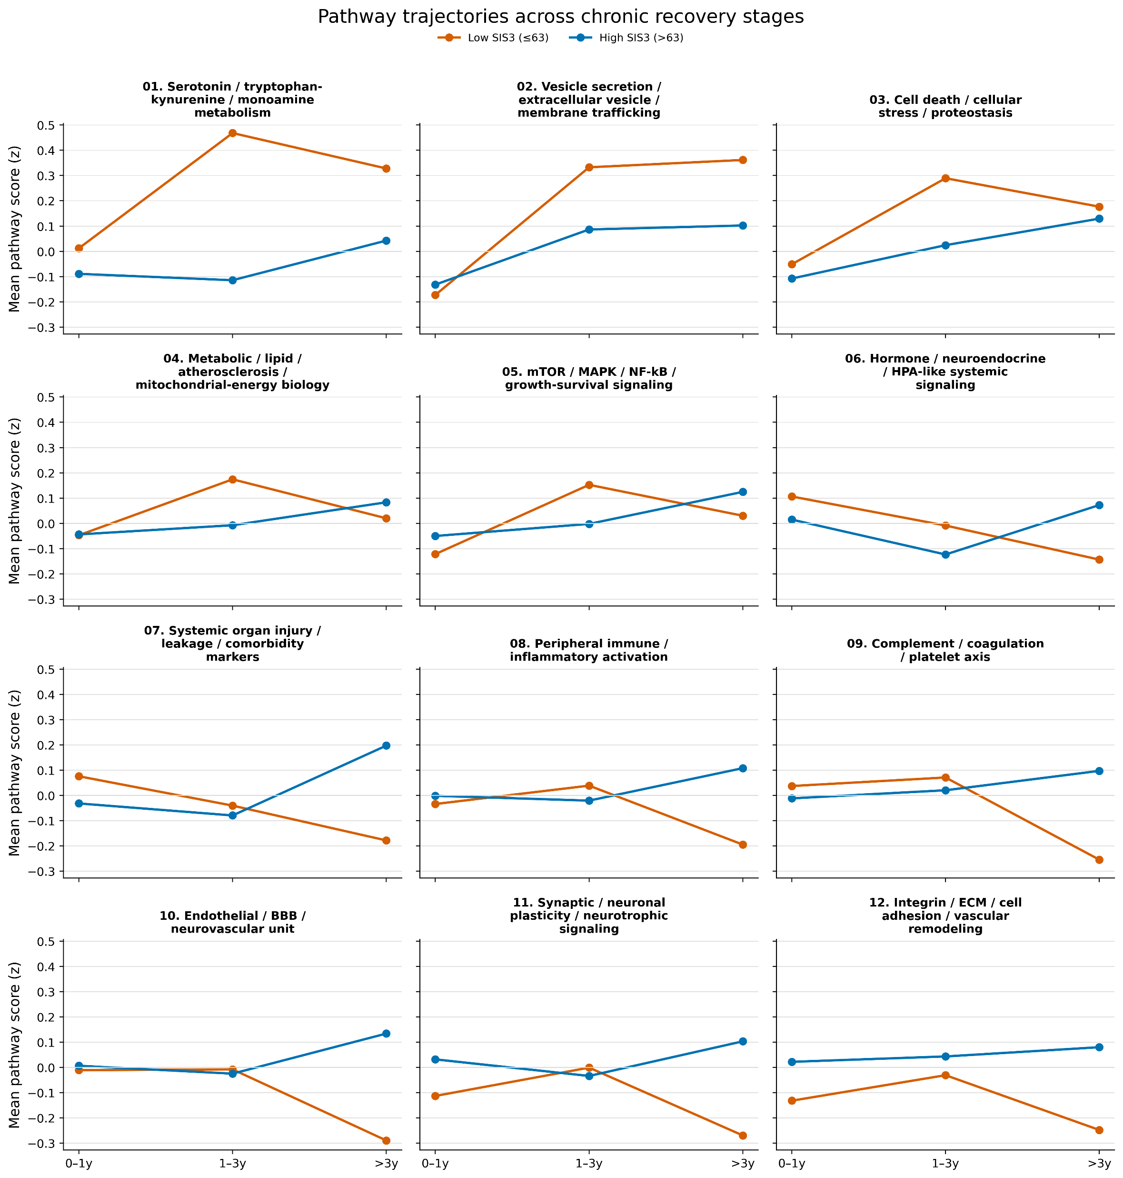
Time-associated biological module trajectories differ between lower and higher SIS3 groups.
Mean biological module scores were plotted across post-stroke time bins for lower- and higher-SIS3 patients. Several modules showed direction-changing patterns across time, especially in the lower-SIS3 group. These patterns suggest that post-stroke mood biology may not follow a simple linear trajectory, and that prediction model should retain broad proteomic information instead of prematurely narrowing to a limited set of “core” proteins or dominant biological modules.

Slide 11
